Slide 1





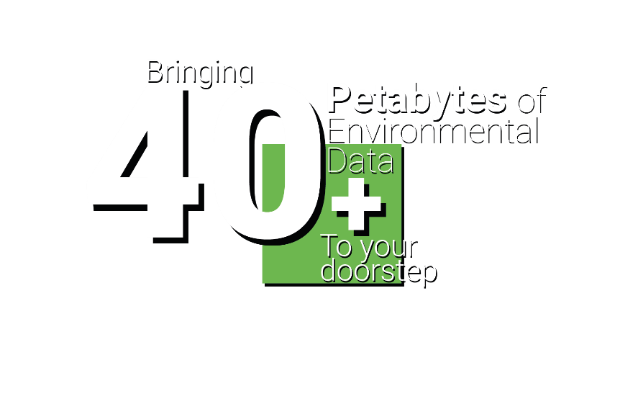

Developing a
Digital Hub and set of Toolkits that exploits environmental and other data (social, economic & health) to create innovative digital services that deliver economic, societal and environmental benefits across the UK
DIGITAL SOLUTIONS HUB
Richard Kingston
Prof of Urban Planning & Geographic Information Science,
The University of Manchester
digital-solutions.uk
@nercdsh
Notes:
Start off with the background to DSH’s overall aim.
Our approach – putting users first and how we gather their requirements.
The focus a bit on how do you wrangle over 40 petabytes of data into a decision support system.
Some early use cases.
What next and questions.

Slide 2

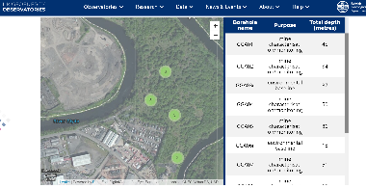





NERC Digital Solutions Programme
5 year £8m investment to build a UKRI ‘national facility’ – the Digital Solutions Hub – during phase 1
NERC’s core focus is to work closely with stakeholders across the public / third sector and industry
  plus those of you who are not environmental scientists in academia
making NERC’s 40+ PBs data more discoverable to non-academic users
to make better use of their data from the 5 data centres
connecting with social, economic, health and other environmental data across the whole of the UK
integrated with JASMIN for analytics and modelling
Post 2025 – phase 2 funding
Notes:
The main focus of Digital Solutions Programme is to build a hub that provides users with what they want and need, rather than what we think they need.

Slide 3











Overall approach
Build it and they will come.
No, no, no.
So, you spent 4 years building this thing, it’s great it can do A, B and C but we also want it to do X, Y and Z !

Slide 4



























(previously PHE)
Notes:
This only captures a fraction of our engaged partners.

Slide 5
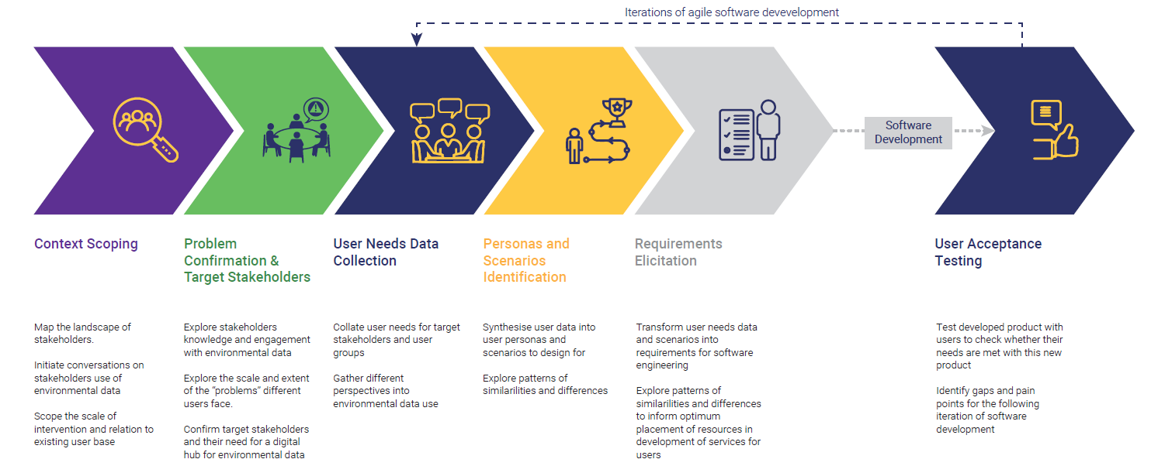
User Needs Mapping Approach
Mar 22 – Jul 22 Sep 22 – Feb 23 Mar 23 – Jul 23 Now (one to one interviews) Ongoing 2nd half 2024

Slide 6
The Landscape Users Operate in
Data is held in lots of places.
Data is not always held in formats, or on systems, that make it easy to search for.
It’s not always obvious what the purpose of different platforms is, and the variety of data they contain.
It is hard to keep up with the ‘sheer range’ of these.
Some platforms are ‘clunky’ to learn and use with multiple clicks needed to get at data, or arduous registration processes.

Slide 7
Key Requirements
Users need sufficient access to the data to quality assure it, clean it and transform it into suitable format.
Reviewing a sample of a dataset may help determine its suitability in an easier way.
Users need to be able to keep track of work and resources they have done on datasets.
Users are keen to avoid duplication of effort – through sharing work they’ve done on datasets and accessing the work others have done.
A way of applying suitable analysis software to data.
Allow users to combine/link their own data with other data they access from DSH as part of analysis.
Notes:
Report about to be published with all the details

Slide 8




User Journey
Prioritise
Understand
Verify
Access
Test
Present
Iterate
Gather
Comprehend
Find
Promote
Process
Manage
Analyse
DEFINE
GET
ANALYSE
SHOWCASE
MANAGE

Slide 9

Archetypes (personas)
The
The
Analyst
Investigator
Analysts monitoring the environment
Analysts answering questions with data
The
The Data
Author
Specialist
Authors of monitoring frameworks
GIS specialists and data support
The Data
The Data
Leader
Steward
Data leaders in organisations
Focusing on data quality and sharing

Slide 10
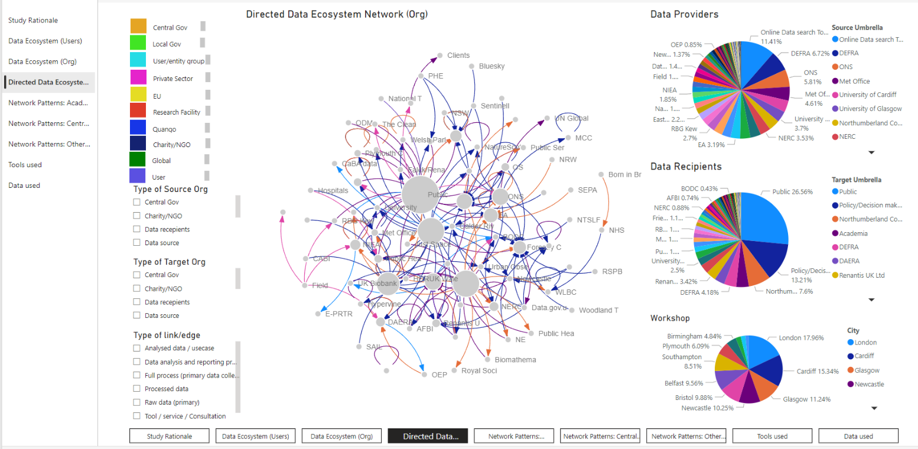
Understanding how users use Data
INTERACTIVE DATASET
273 data transactions
100 users
84 organisations

Slide 11
So, how do you wrangle over 40 petabytes of data
F1. (Meta)data are assigned a globally unique and persistent identifier
F2. Data are described with rich metadata (defined by R1 below)
F3. Metadata clearly and explicitly include the identifier of the data they describe
F4. (Meta)data are registered or indexed in a searchable resource
A1. (Meta)data are retrievable by their identifier using a standardised communications protocol
  A1.1 The protocol is open, free, and universally implementable
  A1.2 The protocol allows for an authentication and authorisation procedure, where necessary
A2. Metadata are accessible, even when the data are no longer available
I1. (Meta)data use a formal, accessible, shared, and broadly applicable language for knowledge representation.
I2. (Meta)data use vocabularies that follow FAIR principles
I3. (Meta)data include qualified references to other (meta)data
R1.1. (Meta)data are released with a clear and accessible data usage license
R1.2. (Meta)data are associated with detailed provenance
R1.3. (Meta)data meet domain-relevant community standards
FAIR Principles
Findable
Accessible
Interoperable
Reusable
https://www.go-fair.org/fair-principles/

Slide 12
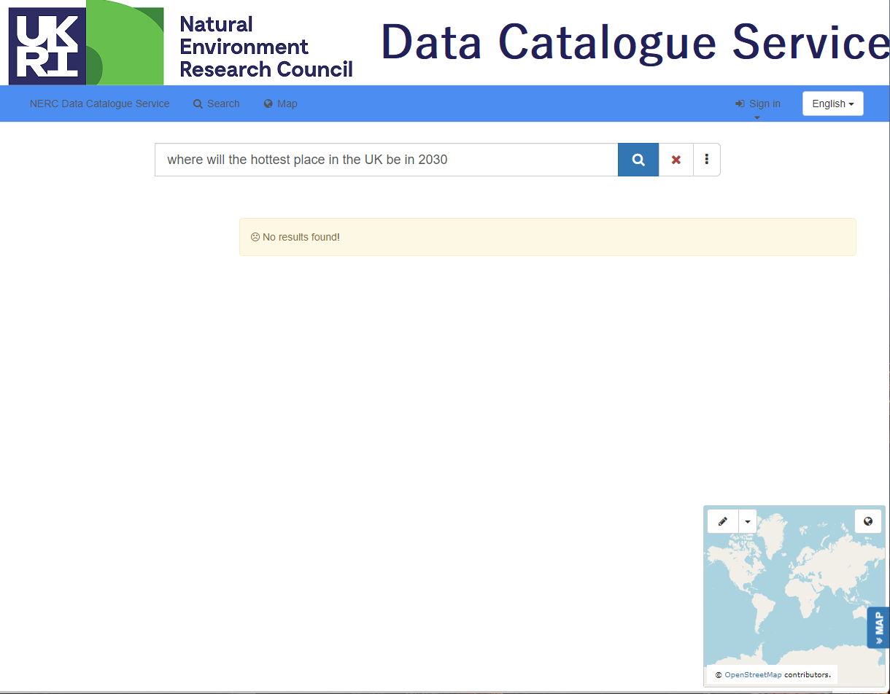
A challenge is knowing what data NERC has
Where will be the hottest place in the UK in 2030?

Slide 13
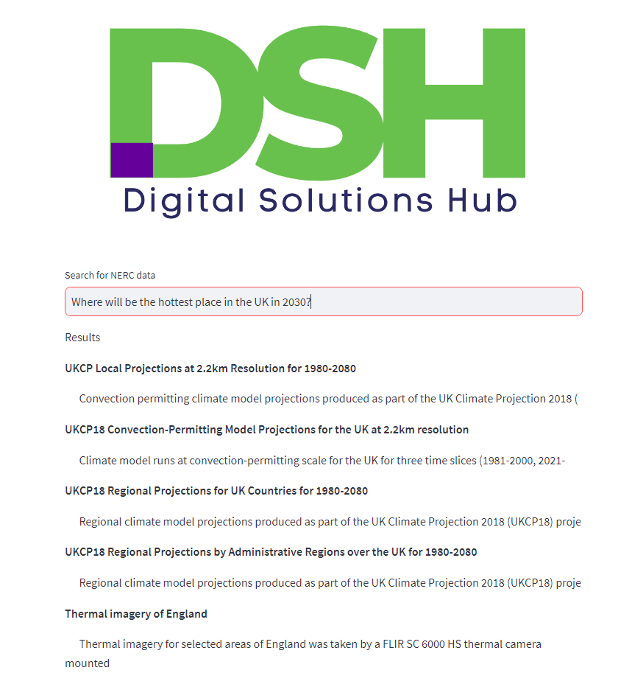
Uses google BERT model
Using a Large Language Model (LLM) we have trained it on all the NERC meta-data records.
When we ask the same question
Our approach searches the meta-data records and now provides a list of relevant datasets to help answer the question.
Next step is to allow user to visualise the data.

Slide 14
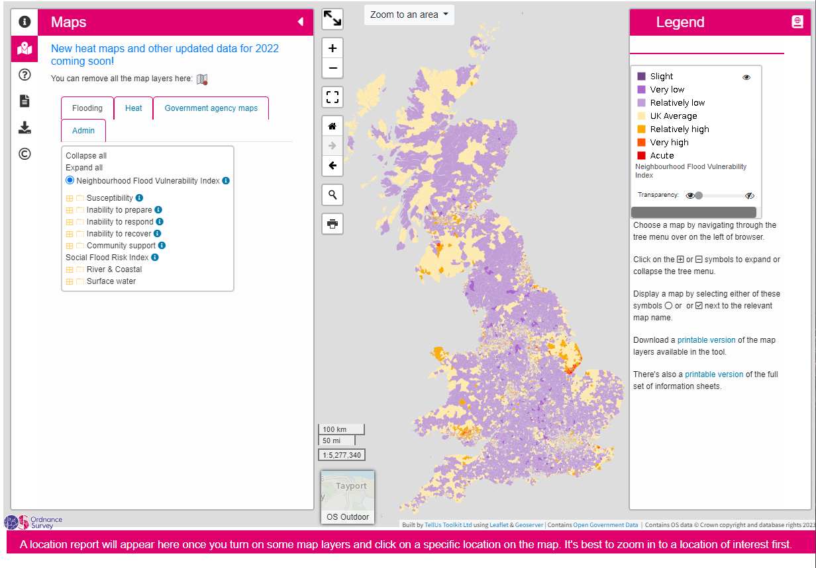
The DSH is not just a data portal
It will run on JASMIN – NERC’s supercomputer in Harwell.
Vast majority of the data is spatial.
As well as the NERC data we are integrating other environmental, social, economic and health data.
Allow users to find and explore data
Also building on previous research using NERC data e.g., www.climatejust.org.uk using UKCP18 climate projections

Slide 15
Responding to user needs
Developing a set of POCs
  allows us to test different data types/formats
  test out different types of functionality
  meet some user requirements
Deliberately using a wide range of data sources and types
  Air pollution and health (NHS, Met Office and Defra)
    along with a Trusted Research Environment
  Housing and environmental constraints (DLUHC and Geospatial Commission)
    modelling net zero implications, biodiversity net gain etc.
  Flooding from rivers, tidal surges, sea level rise etc. (Defra, EA, SEPA, NRW, GAD, LAs)
    impacts on coastal communities
  Heat stress – reducing the impact of the urban heat island (DLUHC, DoT, Defra, EA, LAs)
    Community Earth System Model (CESM) provides state-of-the-art computer simulations of Earth's past, present, and future climate states.
    Run different scenarios and bringing in expertise from Turing Inst.

Slide 16












further details
The Pankhurst Institute
Come and spend time working with us directly in our new home on Oxford Rd.
Report from our user engagement workshops is now available from our website.
Online webinar with ODM on Mon 20th Nov to delve deeper into user requirements
Get in touch and sign-up for our newsletter
  http://www.digital-solutions.uk/
@NERCdsh @gisplanner

